Slide 1
Disaster Response
Drones
Nicolas Giot
AI & IIoT at the Edge

Slide 2
Nicolas Giot
Application Overview
Why and how?
Traditional reconnaissance is slow, limited by terrain and risk to personnel
AI-powered drone with real-time data and autonomous navigation works around the clock and is far more efficient and powerful. Can be used for many things such as:
Post-earthquake structural surveys
Flooded urban area mapping
Search for heat signatures in wildfire zones

Slide 3
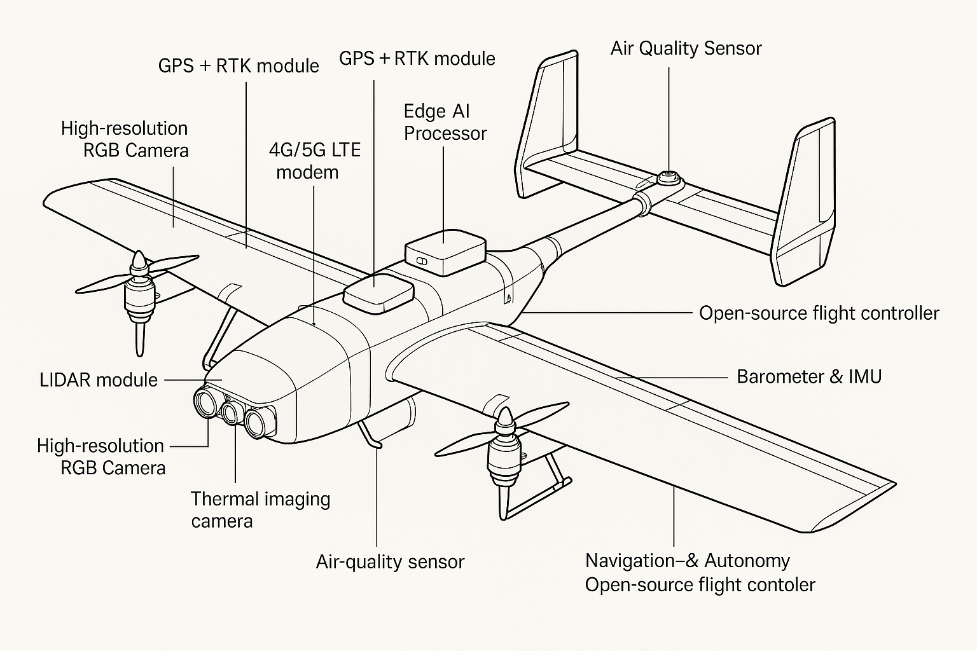
Nicolas Giot
Description
What is it?
There are many considerations
Electric VTOL with fixed-wing configuration for endurance and efficiency. This allows for easy takeoff & recovery, and quick refueling to get back in the air. This will include:
General components
Wingtip vertical lift rotors
Rear pusher propeller for forward flight
Lightweight carbon fiber airframe
Capabilities
Launches from confined areas
Loiters at ~300ft for safe data collection
Real-time switching between hover and cruise modes

Slide 4
Nicolas Giot
Primary functions/capabilities
Primary Functions
Aerial imaging (RGB and thermal)
3D terrain mapping
Air quality scanning
1
AI Integration
Object/person detection via onboard edge models (YOLO v8)
Path planning with obstacle avoidance
Auto-upload key events to command center
2
Human Interaction
Remote override via ground station
Visual confirmation prompts (e.g., “possible human detected – verify?”)
3

Slide 5
Nicolas Giot
IIoT
1
2
3
4
Connecting the web
Core Modules
Sensor Suite
Data Flow Pipeline
IIoT Benefits
- RGB + thermal camera
- LIDAR for terrain mapping
- GPS + RTK for precise geo-tagging
- IMU + barometer for stability
Sensors
→
Edge Compute
→
Ground Station Dashboard
Emergency triggers auto-pushed to response teams
- NVIDIA Jetson for edge inference
- Pixhawk controller running PX4/ArduPilot
- 4G/5G LTE or satellite modem
Allows for quick and effective communication, quickly alerting proper authorities or response teams to the real situation in a disaster situation.

Slide 6
Nicolas Giot
Ethical Considerations
Ensuring that we do it right
Privacy
Sustainability
1
2
Considering accidental surveillance of civilians or private property
Mitigation: onboard data anonymization (face/house blurring
Battery disposal and material sourcing
Mitigation: recyclable battery systems, biodegradable frame parts
Fair Access
Transparency
3
4
Risk of only wealthier municipalities affording this tech
Mitigation: Open-source design and NGO partnerships
Public access to flight paths and recorded data policies

Slide 7
Nicolas Giot
Next steps
Conclusion
1 :
Planning
2 :
Future Enhancements
3 :
Final
Vision
We’re here!
Doing our best to consider the best approach to predicting and mitigating effects of any natural disasters.
Expanding our scope
Swarm support for large-scale area mapping
AI model OTA (over-the-air) updates
Integration with GIS and emergency dispatch platforms
Working on implementing a drone system that empowers first responders with real-time insights, ensuring
Scalability
Ethics
Open Access
Disaster Readiness

Slide 8
Plan
Sketch

Slide 9
Thank you!

Slide 10
Nicolas Giot
Research Information
The drone's core design leverages an electric fixed-wing VTOL frame for its superior endurance and deployment flexibility. The vertical lift motors allow it to launch and land vertically without a runway, ideal for disaster zones with limited space. Once airborne, the drone transitions to efficient fixed-wing flight, conserving energy and enabling longer ranges (50–100 km depending on payload and battery capacity). The average cruising altitude of 300 feet maintains a balance between image clarity, legal height compliance (FAA Part 107), and minimizing urban noise disturbances. VTOL drones also reduce wear on motors by separating lift and propulsion roles, which enhances component lifespan.
Power consumption and battery budgeting are critical. A typical 4S or 6S LiPo battery can power a mid-sized drone for 60–90 minutes under optimal conditions. To maximize range, lightweight carbon-fiber composites, streamlined airframes, and power-efficient AI processors (e.g., NVIDIA Jetson Orin Nano) are essential. A solar-assist module could help extend loiter times in daylight. Advanced AI models for semantic segmentation (e.g., Detectron2 or YOLOv8) are trained to identify key features such as collapsed structures, human signatures in thermal data, and flooded zones—assisting rapid triage from above.
From an ethical perspective, this application raises issues of surveillance, airspace use, and emergency decision-making by algorithms. In dense urban zones, drones could unintentionally capture private property images, requiring strict onboard anonymization protocols and data retention limits. Compliance with transparency standards—such as disclosing flight paths to municipalities—and ensuring real-time human oversight are essential for ethical deployment. Battery disposal, noise ordinances, and job displacement (i.e., replacing certain human reconnaissance roles) are further concerns that must be mitigated through design choices, public engagement, and regulation adherence.

Slide 11
Interesting sources
Murphy, R. R. (2019). Introduction to AI robotics (2nd ed.). Cambridge, MA: MIT Press.
Jobin, A., Ienca, M., & Vayena, E. (2019). The global landscape of AI ethics guidelines. Nature Machine Intelligence, 1(9), 389–399. https://doi.org/10.1038/s42256-019-0088-2
UNESCO. (2021). Recommendation on the ethics of artificial intelligence. Paris, France: United Nations Educational, Scientific and Cultural Organization (UNESCO). https://unesdoc.unesco.org/ark:/48223/pf0000381137
Motlagh, N. H., Bagaa, M., & Taleb, T. (2017). UAV-based IoT platform: A crowd surveillance use case. IEEE Communications Magazine, 55(2), 128–134. https://doi.org/10.1109/MCOM.2017.1600581CM

